Slide 1
Retention Analysis
Data Exploration and Business Hypothesis Testing

Slide 2
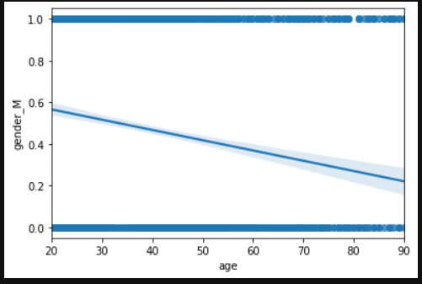
Inactive-to-active consumers
There 2378 consumers who went from Inactive at the start to Active at the end of the period.
Within this category, the mean age of male consumers is 42.09 years, while the mean age of female consumers is 36.50 years.
Below is a regression plot of Gender vs Age of Inactive-to-Active consumers. Here, 1 on the Y-axis represents male consumers, and 0 represents female consumers.

Slide 3
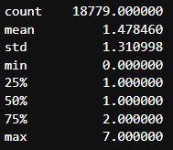
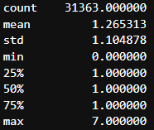
Below-average vs above-average income
Mean of the gross income column is $120915.23, after removing outliers (people with >$500,000 gross income were removed).
There are 18,779 consumers with more than average income. On the other hand, there are 31,363 consumers with below average income.
The ‘activity level’ of a consumer has been calculated as sum of three columns – number of credit cards, number of loans, and number of products.
Below is the comparison of activity between the two groups:
Consumer activity – above-average income
Consumer activity – below-average income

Slide 4
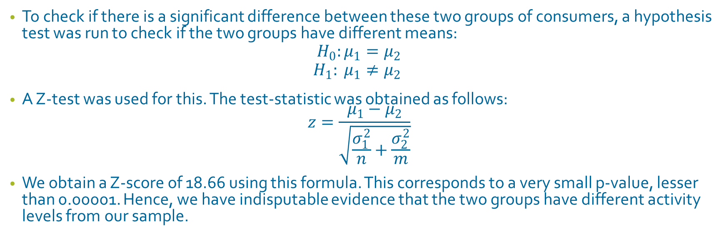
Below-average vs above-average income
To check if there is a significant difference between these two groups of consumers, a hypothesis test was run to check if the two groups have different means:
$$H_{0}:μ_{1}=μ_{2}$$
$$H_{1}: μ_{1}≠μ_{2}$$
A Z-test was used for this. The test-statistic was obtained as follows:
$$z=\frac{μ_{1}−μ_{2}}{\sqrt{\frac{σ_{1}^{2}}{n}+\frac{σ_{2}^{2}}{m}}}$$
We obtain a Z-score of 18.66 using this formula. This corresponds to a very small p-value, lesser than 0.00001. Hence, we have indisputable evidence that the two groups have different activity levels from our sample.

Slide 5
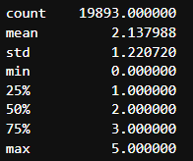
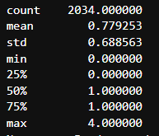
Active vs Active-to-Inactive consumers
There are 19,893 consumers who were active throughout the 6-month period. On the other hand, there are only 2034 consumers who shifted from active to inactive in the 6 month period.
Consumers who were active throughout, had a mean of 2.138 in terms of number of products. In contrast, consumers who switched from active to inactive had only 0.779 mean number of products.
Even without a hypothesis test, we can see that these two groups are significantly different. Still, we confirm this with a two sample Z-test, and indeed, the Z-statistic is 77.42, which suggests we have indisputable evidence that the two groups have significantly different means.
Number of Products of active consumers
Number of Products of active-to-inactive consumers

Slide 6
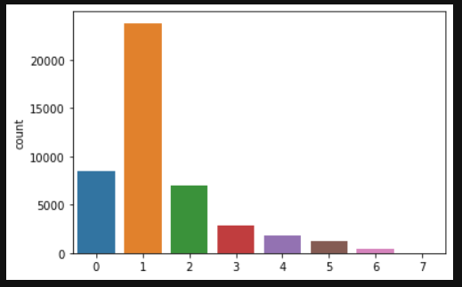
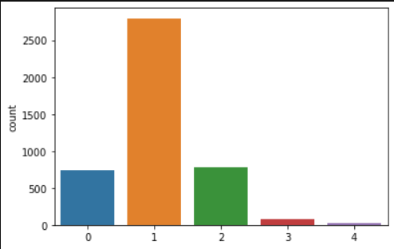
Consistent vs Inconsistent Consumers
There are 45,730 consumers who fall under the category of consistent – that is, they either stayed active or stayed inactive throughout the 6 month period.
There are only 4412 consumers in the inconsistent category. These consumer switched their state from active to inactive, or vice versa, in the 6 month period.
Comparing activity levels of the groups, we find consistent consumers have higher levels of activity. Consistent consumers even have activity levels of 5, 6 or 7, while inconsistent consumers’ activity level tops out at 4.
However, the majority of consumers have activity level of 1 in both groups – the mode remains same.
Consistent Consumers’ activity
Inconsistent Consumers’ activity

